Slide 1
Basics Workshop
Alexander Rössler

Slide 2
Overview
About Me
Vagrant Box
Files
HAL
CNC
Machinetalk

Slide 3
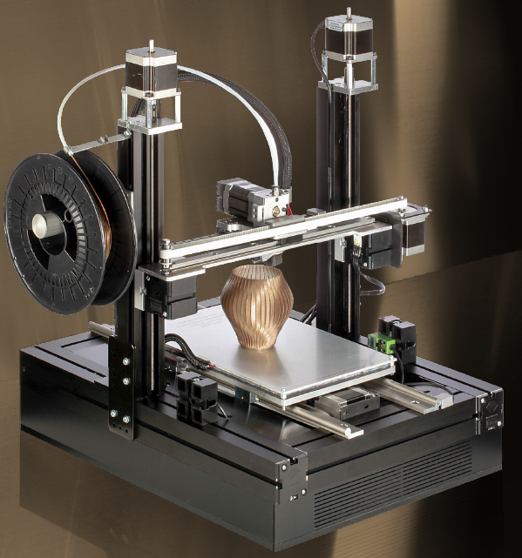
About Me
Alexander Rössler
Embedded Systems
OpenSource community
3D printing
Zühlke Engineering

Slide 4


Vagrant Box
VirtualBox
Jessie
LXDE
Machinekit packages
Qt SDK
Git repostories
https://github.com/strahlex/machinekit-vagrant

Slide 5
Files
.hal – HAL configuration
.ini – Machine parameters
run.py – Run-file
launcher.ini – mklauncher file

Slide 6
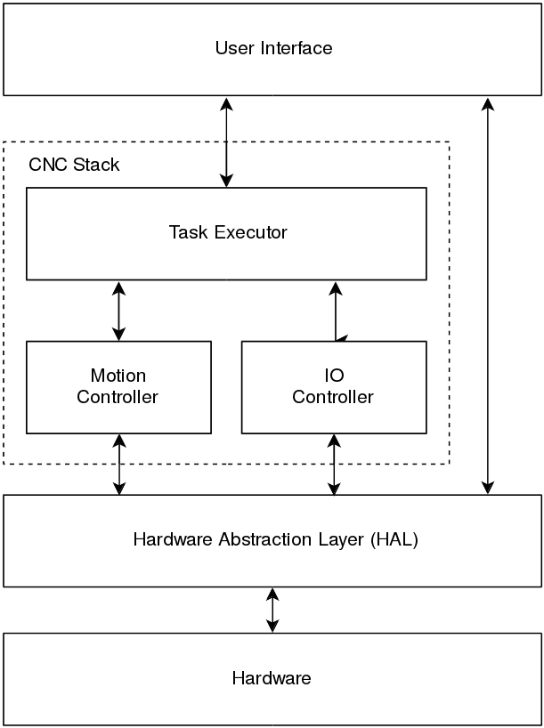
Machinekit Architecture

Slide 7
Links
Demo created during workshop
  https://github.com/strahlex/machinekit-workshop-demo_electrolab_july-2016
Git repositories and resources used during workshop
  https://github.com/cdsteinkuehler/bobc_hardware/blob/CRAMPS/CRAMPS/CRAMPS.v1.0.sch.pdf
  https://github.com/machinekit/machinekit/blob/master/configs/ARM/BeagleBone/CRAMPS/CRAMPS.hal
  https://github.com/strahlex/MendelMax-CRAMPS/blob/master/cramps.py
  https://github.com/machinekit/machinekit/blob/master/src/hal/i_components/sum2.icomp
  https://github.com/strahlex/anddemo
  https://github.com/strahlex/BBIOConfig
  https://github.com/cdsteinkuehler/beaglebone-universal-io
Machinekit website
  http://machinekit.io

